Slide 1
Heart Disease Prediction Model
By Irine Tracy

Slide 2
Data Source
The data is sourced from Heart Disease Database for cleveland , https://archive.ics.uci.edu/ml/datasets/Heart+Disease
This project will use 14 attributes only.

Slide 3
Introduction
Problem Statement
According to (WHO 2022),Noncommunicable diseases (NCDs) kill 41 million people each year, equivalent to 74% of all deaths globally.
Cardiovascular diseases which include heart disease account for most NCD deaths, or 17.9 million people annually, followed by cancers (9.3 million)
Detection, screening and treatment of NCDs, as well as palliative care, are key components of the response to NCDs.
Machine intelligence can convert raw clinical data into an informational source that helps make decisions and predictions especially in diagnosis and prediction(Doppalla,2022).

Slide 4
Introduction cont’d
Purpose
To explore and visualise the given data and use it to develop an Heart Disease risk prediction model to help prioritise interventions to mitigate the correlates of heart disease
Data Attributes
age: age in years,sex: sex (1 = male; 0 = female),cp: chest pain type(Value 1: typical angina,Value 2: atypical angina, Value 3: non-anginal pain, Value 4: asymptomatic),trestbps: resting blood pressure (in mm Hg on admission to the hospital), #chol: serum cholestoral in mg/dl,fbs: (fasting blood sugar > 120 mg/dl) (1 = true; 0 = false),restecg: resting electrocardiographic results (Value 0: normal,Value 1: having ST-T wave abnormality (T wave inversions and/or ST elevation or depression of > 0.05 mV) Value 2: showing probable or definite left ventricular hypertrophy by Estes' criteria),thalach: maximum heart rate achieved exang: exercise induced angina (1 = yes; 0 = no),oldpeak = ST depression induced by exercise relative to rest,slope: the slope of the peak exercise ST segment (Value 1: upsloping, Value 2: flat,Value 3: downsloping),ca: number of major vessels (0-3) colored by flourosopy,thal: 3 = normal; 6 = fixed defect; 7 = reversable defect,num:diagnosis of heart disease (angiographic disease status)(Value 0: < 50% diameter narrowing, Value 1: > 50% diameter narrowing(in any major vessel)

Slide 5
Data Preprocessing
The data is preprocessed
This data contains 303 entries with no missing values.
All columns categorical with the target column showing those at risk of heart disease being 165 persons as shown:

Slide 6
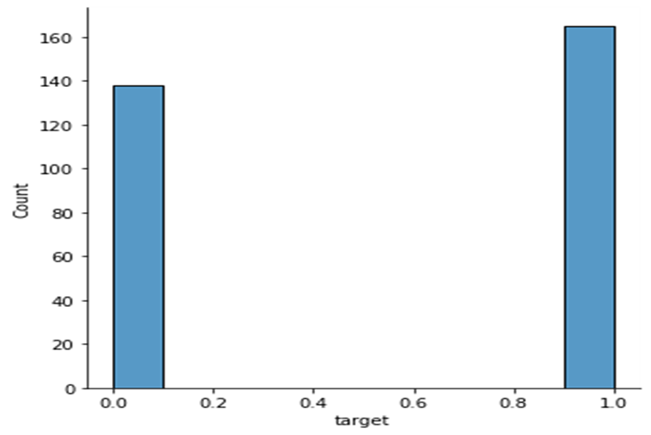
Distribution of those at risk of heart disease

Slide 7
Data visualization for correlation and relationships
Pair plot and heat map have been generated to help visualize the data
As shown in the following slides

Slide 8
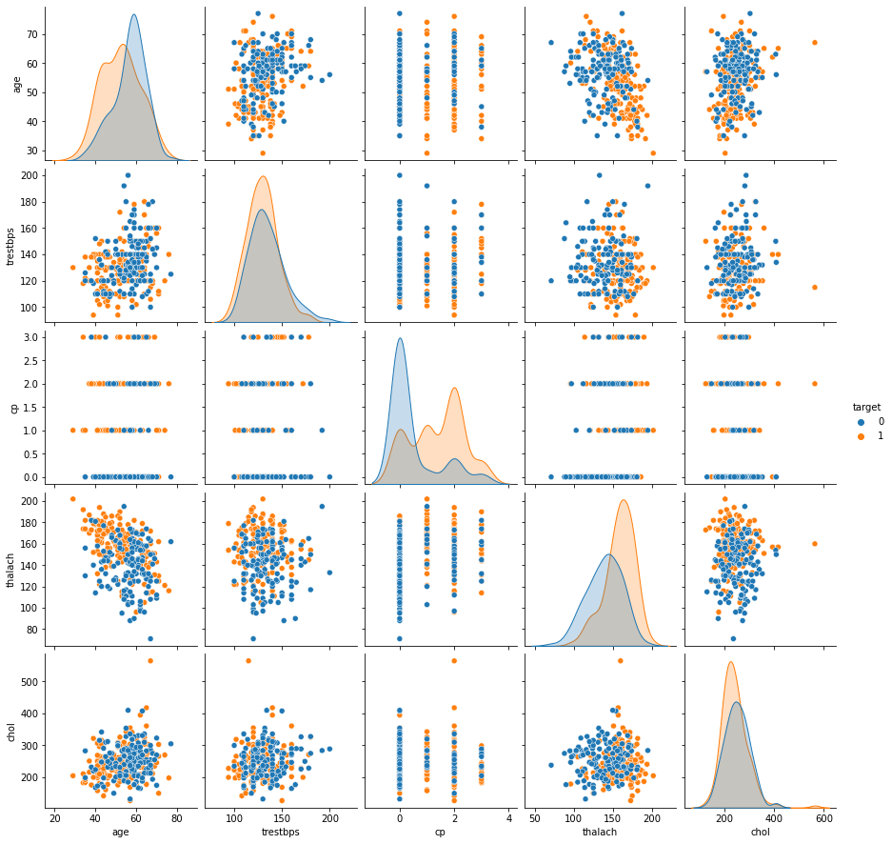
Pair plot:target vs independent vaiables

Slide 9
Pairplot showing relationship between variables
Heart disease Risk peaks at:
around 60 years of age
200mmhg resting blood pressure on admission
Presenting with typical –atypical angina
200mmhg maximum heart rate achieved post exercise
500mg/dl serum cholesterol level

Slide 10
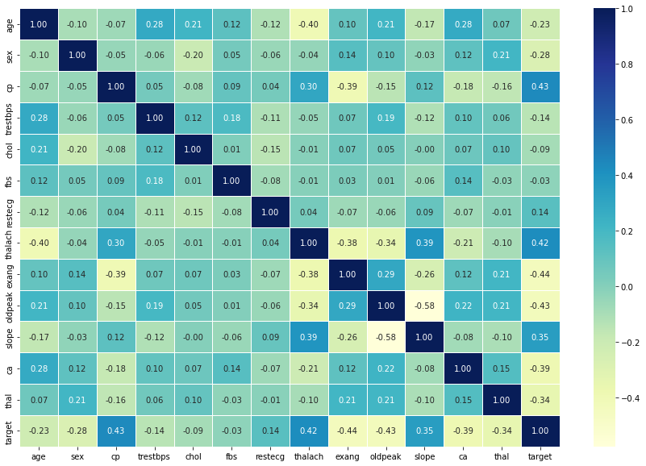
Heatmap showing relationship between variables

Slide 11
Correlation between target and independent variables from heat map
From the heat map, chest pain, maximum heart rate achieved and the slope of the peak exercise ST segment are positively correlated with risk of heart disease

Slide 12
Model Output
The test model score is 86.8%, with accuracy of 87% hence can predict heart disease with 87% accuracy.
precision recall f1-score support
0 0.89 0.83 0.86 29
1 0.85 0.91 0.88 32
accuracy 0.87 61
macro avg 0.87 0.87 0.87 61
weighted avg 0.87 0.87 0.87 61

